Slide 1
Intelligent Notification System(INS)
A smart way of managing events at UTD

Slide 2
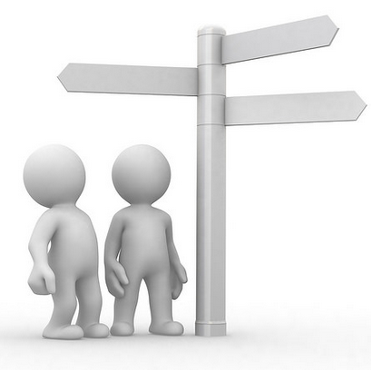
OVER VIEW
Revised Vision And Glossary
Refined Use Cases
System Sequence Diagram
Sign Up & Log In
Event Retrieval
ER Diagram
Domain Model
Class Diagram
Project and Team Management
Working Demo
Plans for the Iteration 2.

Slide 3
VISION AND GLOSSARY
High-Level Goals
Create a user sign up page. One time process for every user.
Ability of the user (those who signed up) to login and manage their preferences.
Create a preferences section based on events categorization. This will be reflected on the UI as well as DB
Maintain a database for users (who signed up) for the application and for events extracted
Monitor the events database regularly to check the new events as well as expired events
Maintain the users database to reflect their modified preferences
Send sms to the respective user 15 mins before the start of the event (based on his selected preferences)
Constraints
User needs to sign up with the system (one time process).
User needs to verify his validity by entering the passcode he receives from the email after sign up.
User needs to select his preferences and currently enrolled class number and section.
User needs to have a mobile where he can get a notification using sms.

Slide 4
Use case #1 | Comment
Use Case Name | Sign Up
Purpose | To create a new account record for the customer that contains personal information.
Scope | IN System
Level | Primary
Primary Actor | UTD Students(users), IN System
Supporting Actor | IN System
Pre-Condition | Valid email address
Main Success Flow | User goes to the SignUp page. Enters First name, Last name, UTD email, password. Hit the Register button. User will get a confirmation email along with a 4 digit pass code and a link to redirect to the Email verification page. Enter the 4 digit code and hit the submit button The system verifies the user based on the code he enters and grants him access to the system. The user account is completely created, verified and he is redirected to the dashboard.
Alternate Flow | An account already exists with the mentioned email address User leaves the First name, last name, email id or password blank. User enters an invalid email id. User enters a non-UTD email id. User does not get an email confirmation along with the passcode. User enters an invalid code. User leaves the code field empty and hits the submit button.
Post Condition | User account is created and the personal information will be saved on the system.
Stakeholders and Interests Lists | Students, IN System
Special Requirements | The users are simulated and accordingly mapped in the customized database

Slide 5
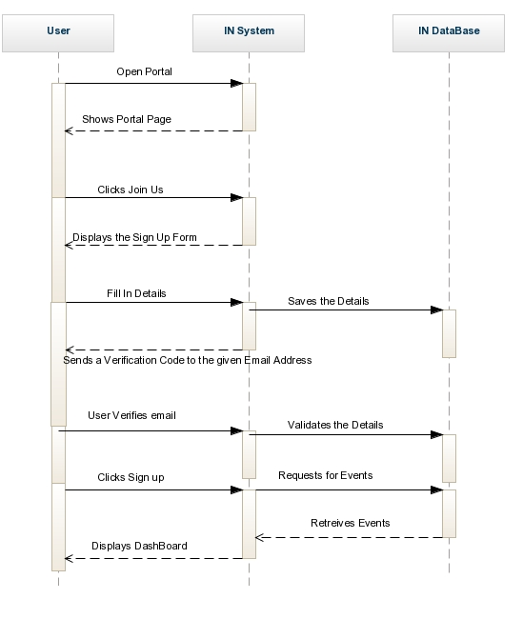
SEQUENCE DIAGRAM FOR SIGN UP

Slide 6
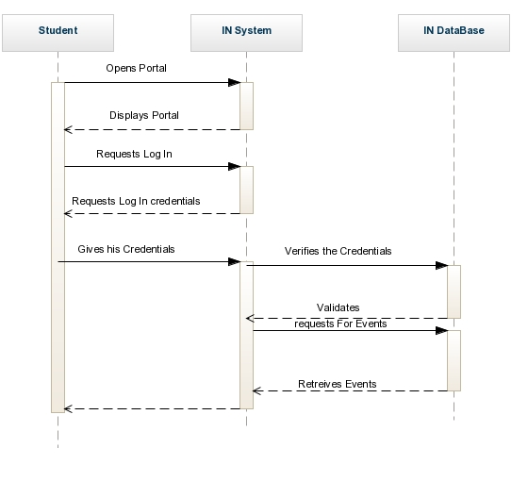
SEQUENCE DIAGRAM FOR LOG IN

Slide 7
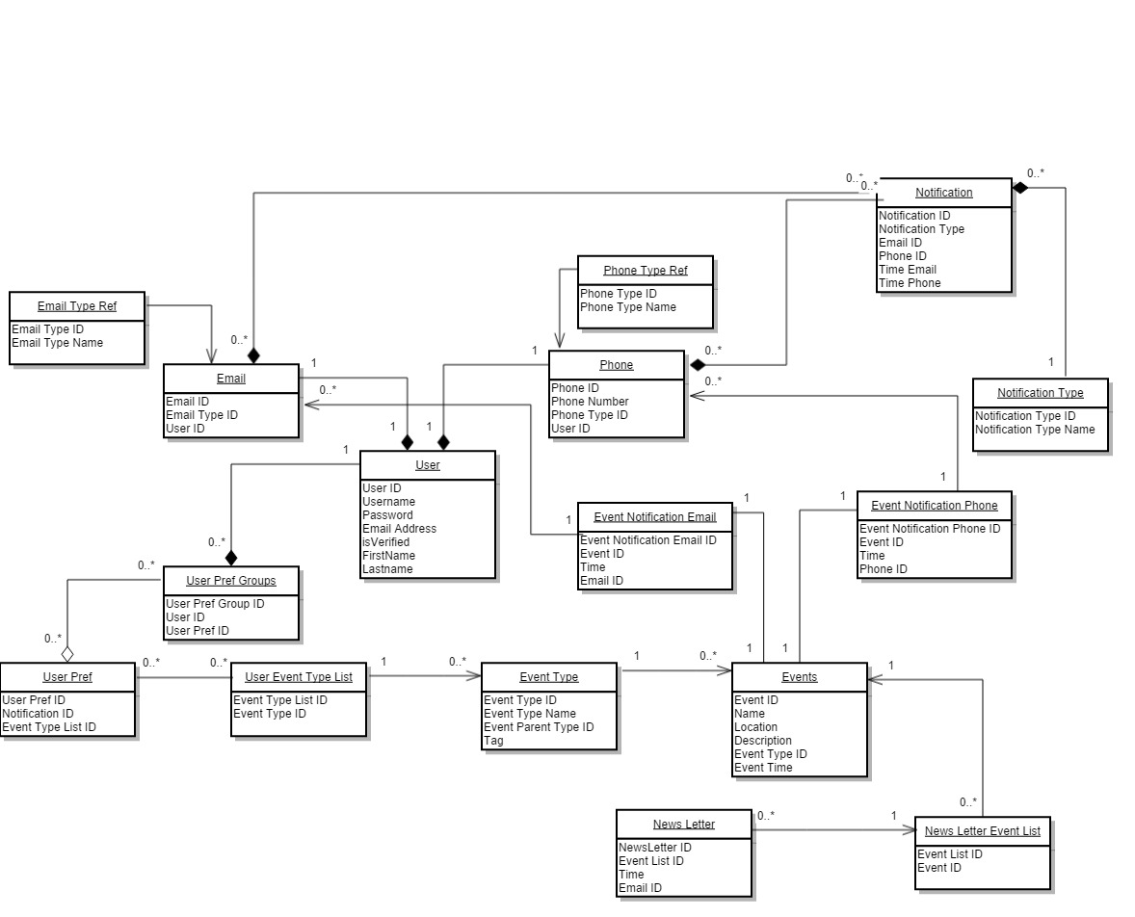
DOMAIN MODEL

Slide 8
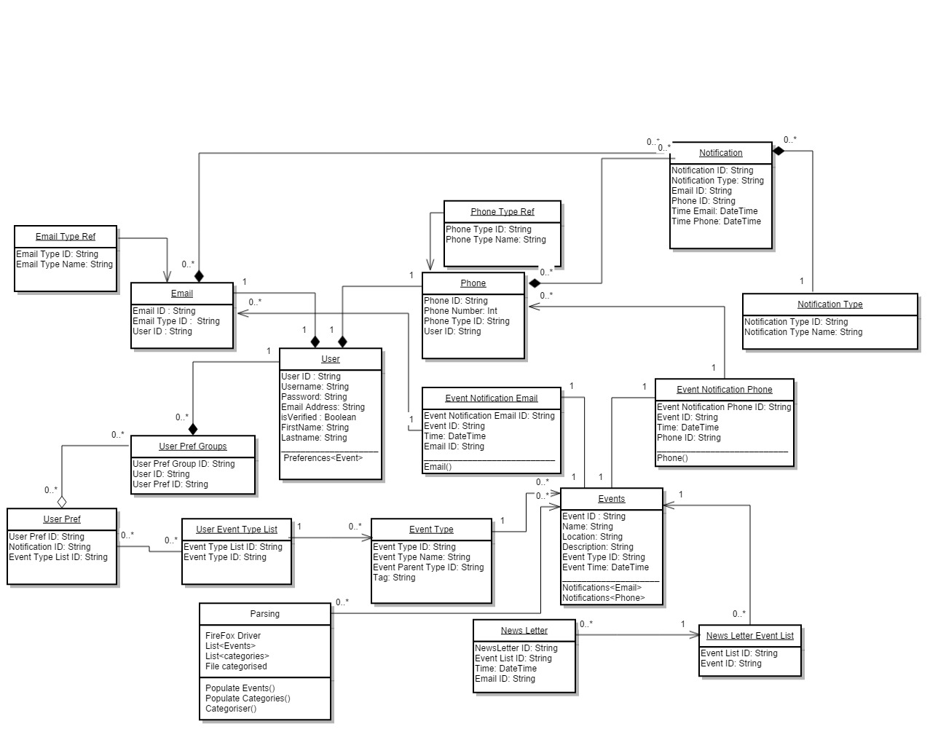
CLASS DIAGRAM

Slide 9
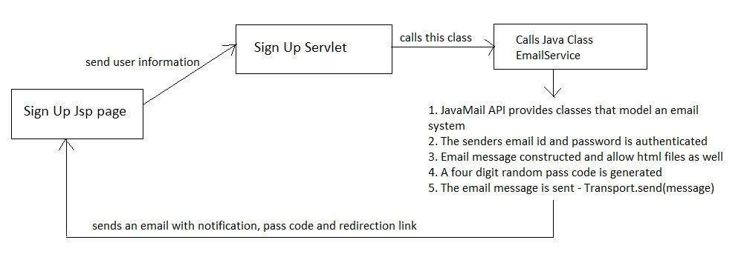
SIGN UP FLOW

Slide 10
OPERATION CONTRACT
Contract Name: Sign Up Operation: Sign Up (FirstName: String, LastName: String, EmailID: String, Password: String, Confirm Password: String) Cross Reference: Use Cases: Sign Up Preconditions: The user should have a valid Email ID. Post conditions: A User instance ‘U’ was created U was associated with the current credentials (association formed) Attributes of ‘U’ were initialized (attribute modification) | Contract Name: Log In Operation: Log In (EmailID: String, Password: String) Cross Reference: Use Cases: Log In Preconditions: The user should have a valid log In credentials Post conditions: A Retrieve Events Re instance was created Re was associated with the current credentials (association formed) Attributes of Re were initialized (attribute modification)

Slide 11
EVENT RETRIEVAL
Selenium is used for scraping through the web pages.
The page is parsed through to fetch events.
The category list generated is used to classify the events.
The event page is parsed through to fetch the event description and to determine the categories the event belongs to.
The categorized list is updated in the database.

Slide 12
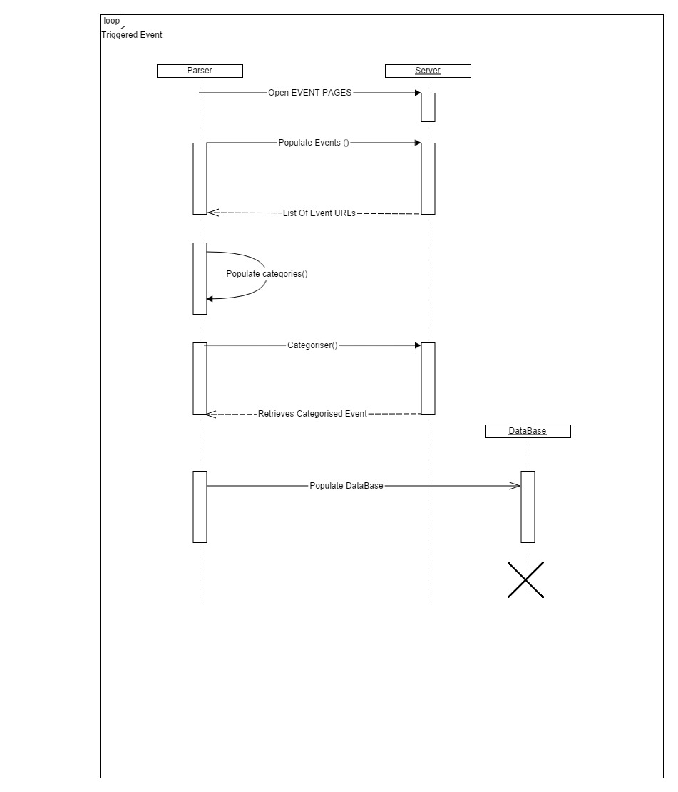
SEQUENCE DIAGRAM FOR EVENT RETRIEVAL

Slide 13
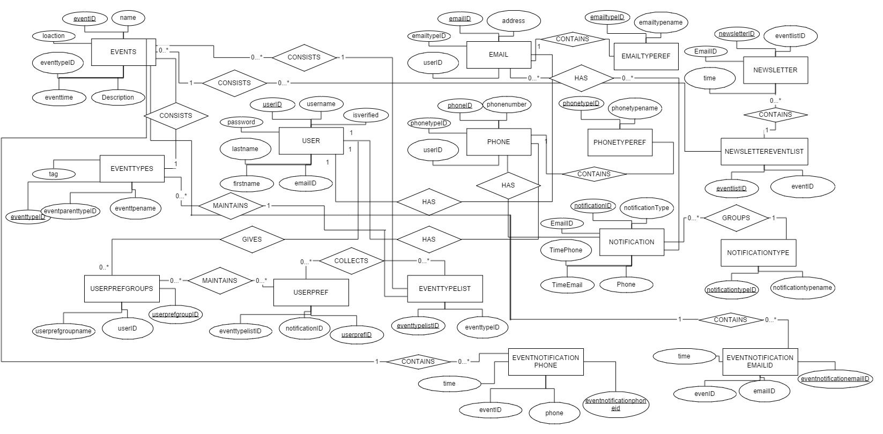

Slide 14
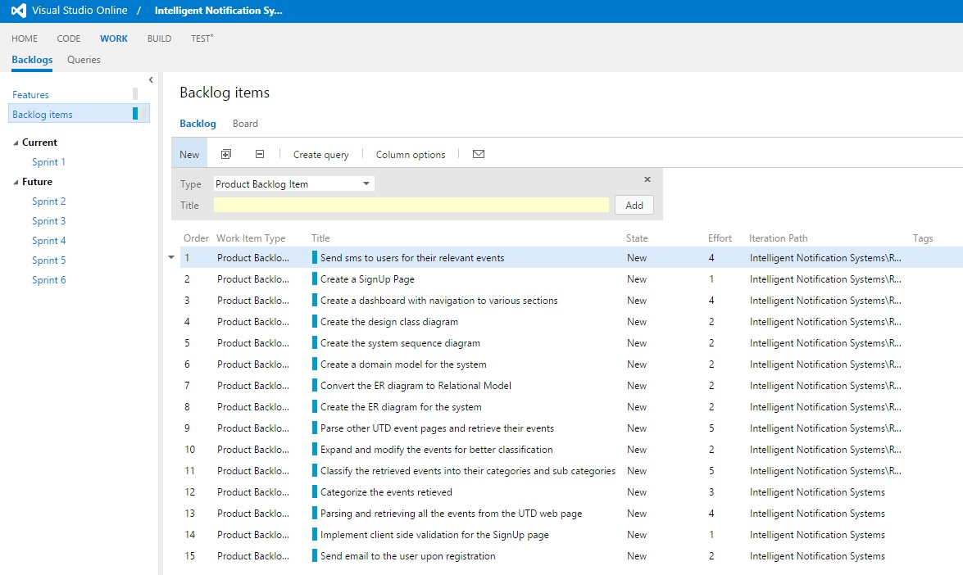
PROJECT MANAGEMENT

Slide 15
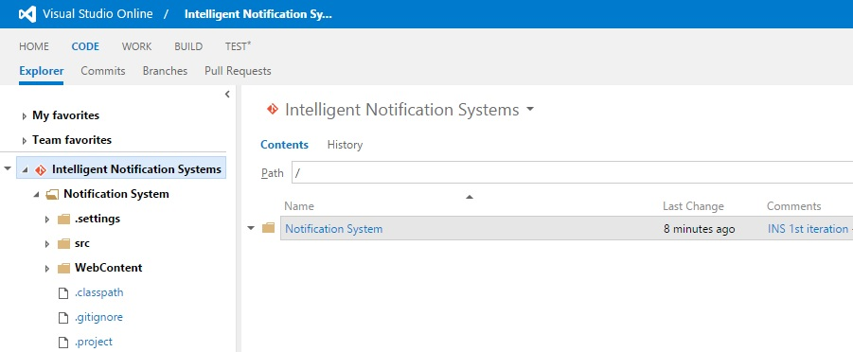
COMMON WORKSPACE

Slide 16

WORKING DEMO

Slide 17


PLANS FOR ITERATION 2
Implementation of Edit preferences
Implementation of Dash Board
Basic Structure of Notification System

